Slide 1
Predicting CLV by Customer Profile
Mini Project 2

Slide 2

Scenario
Client – CEO of US Car Company
Wants to improve profitability
Wants to utilize marketing budget effectively
Gave you some data to work with

Slide 3
Problem statements
Who are our most valuable customers?
What is the average CLV? (Customer Lifetime Value)
Can we predict CLV of a new customer?

Slide 4
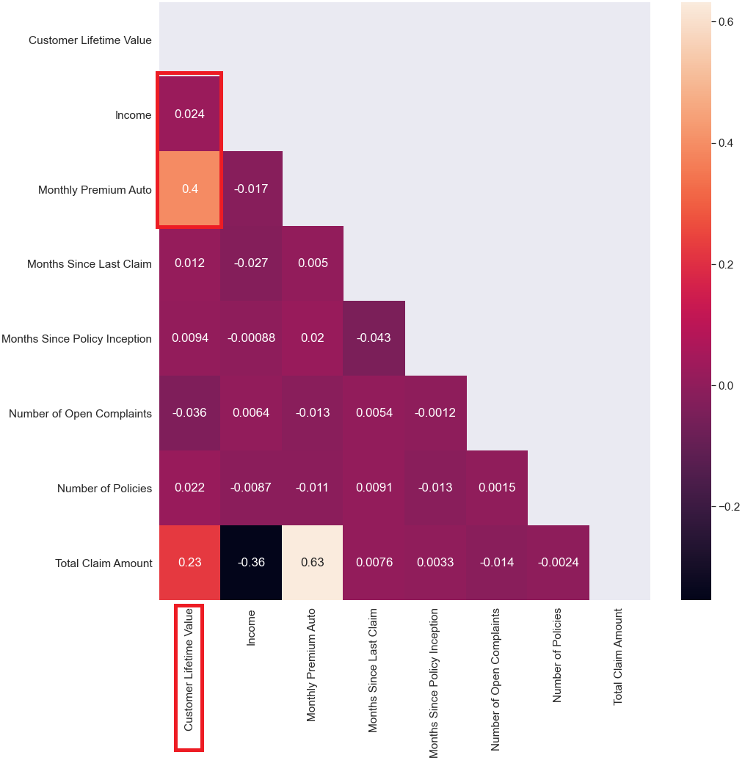
Important correlations
Correlated: Monthly Premium Auto
Income not correlated
Goal: To target high CLV profiles

Slide 5
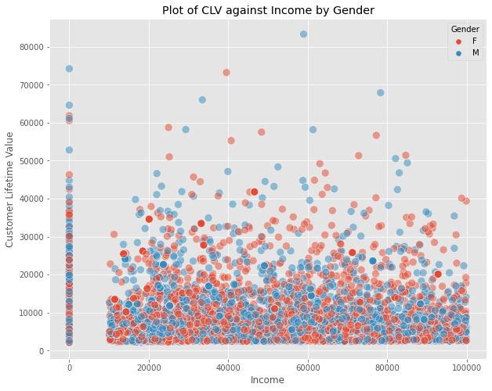
No clear correlation by income or gender

Slide 6
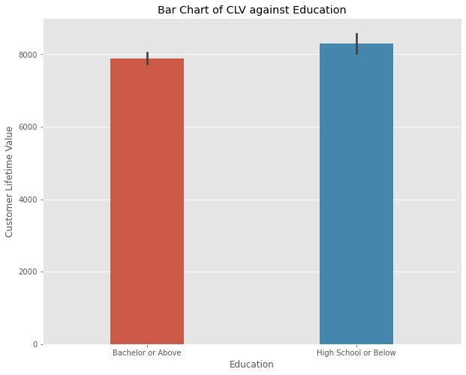
No clear separation of CLV by education

Slide 7
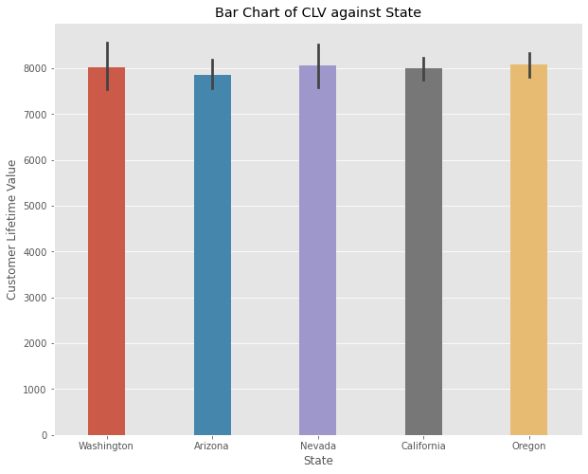
No clear CLV separation by state

Slide 8
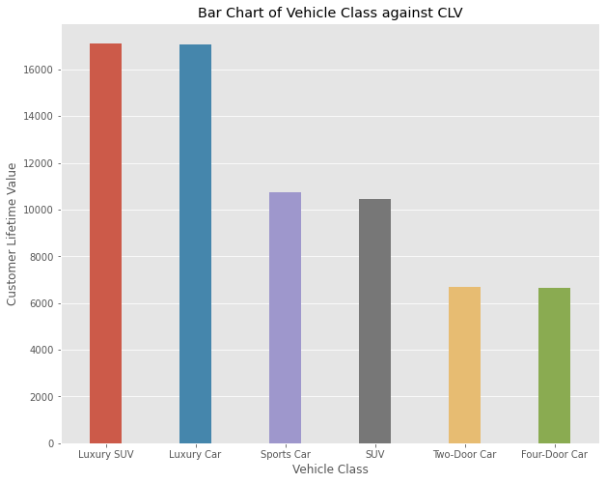
Luxury car owners have higher CLV

Slide 9
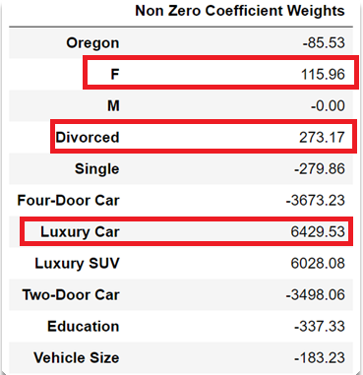
Who is our idea customer?
Female
Divorced
Owns a luxury car
High school diploma
What the CLV?
CLV is 3 times more than the 50th percentile

Slide 10



Suggested business actions
Launch marketing campaigns to target single moms
Get sales staff who can connect with them
Explore partnership opportunities high-end supermarkets/gyms

Slide 11
SUMMARY

Slide 12


Profile
Business Strategies
Female
Divorced
Owns luxury Car
Marketing
Sales staff
Partnerships

